Slide 1
Generating Code From Natural Language Descriptions
Submitted By:
Nanda Gopala Krishna. V
Mahesh Chowdary. K
Sukumar. R
Faculty: Dr. G. Michael

Slide 2
ABSTRACT
One of the most persistent challenges in the world of software engineering has been the attempt to bridge the gap between human language and computer code.
We are getting closer to achieving this aim thanks to recent developments in machine learning (ML) and natural language processing (NLP).
This study examines the approaches, strategies, and difficulties associated with the developing field of producing code from descriptions written in natural language.
We analyze the drawbacks and moral dilemmas of this technology as well as its possible effects on software development, teamwork, and accessibility.

Slide 3
INTRODUCTION
The capacity to smoothly convert human intent into executable code has long been a sought-after goal in the dynamic world of software development.
Now that Natural Language Processing (NLP) and Machine Learning (ML) have taken off, science fiction can no longer contain this dream.
The advent of methods for producing code from descriptions in natural language signals the beginning of a new era in software engineering accessibility and efficiency.
This ground-breaking method aims to democratize coding by removing obstacles for people with different degrees of programming experience.

Slide 4
METHODOLOGIES AND TECHNIQUES
Natural Language Understanding (NLU)
Code Representation
Training Data
Error Handling and Correction
Integration
Deployment

Slide 5
PROCESS OF CODE GENERATION
Data Collection
Code Generation
Train the Model
I/P Data
Client Server Connection
Client Server Application
Response Generation

Slide 6
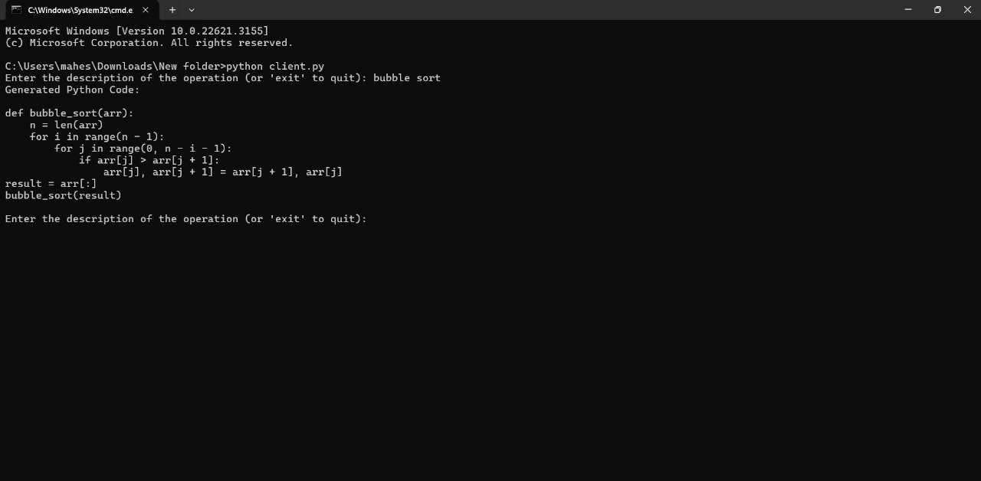
RESULT

Slide 7
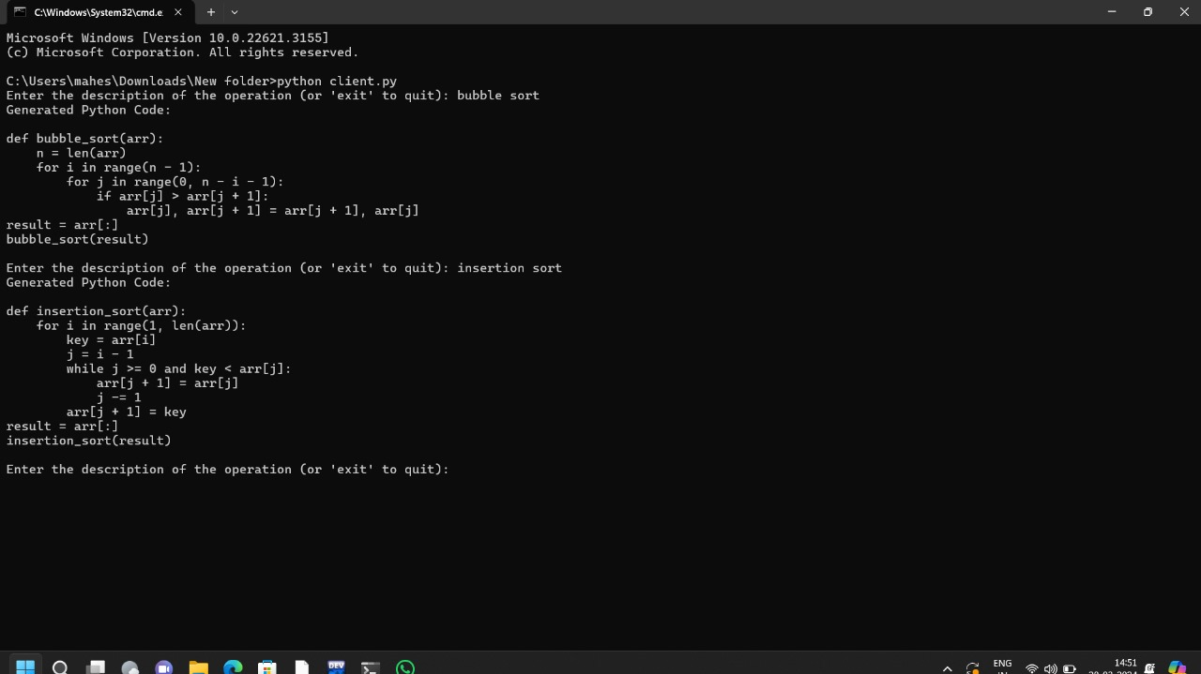

Slide 8
CONCLUSION
To sum up, producing code from theoretical descriptions of natural language has a number of benefits in terms of readability, accessibility, and simplicity of use. Developers can successfully bridge the gap between natural language descriptions and executable code by using an organized strategy that includes precisely identifying the problem, describing algorithmic steps, converting them into code blocks, and offering thorough explanations and examples. Improved comprehension, teamwork, and reproducibility in software development processes are fostered by this theoretical framework. It also makes it easier to integrate code generation tools with natural language processing techniques, which opens the door to more effective and user-friendly programming workflows.

Slide 9
THANK YOU

